Slide 1
Ethics & organizations
2012

Slide 2
Plan for Today
1. Professional Relations with Clients & Employers
2. Contracts
3. Pressures on Professionals from Organizational
4. Structure & Leadership Styles.

Slide 3
A professional relationship
What does it entail?
It refers to services a professional provides to a client or an employer.
Code of ethics understands “client” as a person to whom an engineer provides professional services, including an employer.

Slide 4
Types of Professional Relationship
Professional relations
Ideal-type Model
Invisible Client Model

Slide 5
Ideal-type Model
Model of professional relationship
Client is dependent on professional for problem identification and for remedial actions
Professional provides their skill and judgement directly to client
Dependency of client high and so need for professional’s ethics & competence is high
Key Points
Professional is largely autonomous
Professional association provides the major quality control factor to services provided

Slide 6
Invisible Client Model
Model of professional relationship
Professionals are employed to provide services within an organization
Employer acts in the needs of customers and shareholders
Employer dictates standards, ethics, pay, work etc
Key Points
Professional is less autonomous
Pressure to abandon professionalism to advance in the organization

Slide 7
Contract

Slide 8
Contract
A contract is a voluntary agreement made between at least two persons with the intention of creating a legal obligation.
A contract in Canada (in common law) has five elements:
A mutual intent to enter into a contract.
An offer made and accepted.
A consideration of benefit or motive behind the contract.
Legality of the contract
All parties should have requisite capacity – legal persons.

Slide 9
Different types of Work/Employment Contract
Professionals sign different contracts
Regular Employees – an individual who works for an employer and is entitled to wages under an employment contract that controls the details of work performance.
Contract Employees – an individual who has an employment contract for a fixed term.
Independent Contractors – an individual who has a contract for services with the client or customer to undertake a specific project but who is left free to do the assigned work.

Slide 10
Determining Employment Relationship
Four factors to distinguish between an employee or an independent contractor
Control – who controls the work conditions such as when to come to work.
Ownership of Tools – who owns tools to accomplish task
Chance of Profit – who benefits from any profits from the task
Risk of Loss – who bears losses from doing the task

Slide 11
Organizational Behavior

Slide 12
Organizational Behaviour (OB)
Broadly OB can be conceptualized as studying three major subtopics:
individual processes
team processes
organizational processes

Slide 13
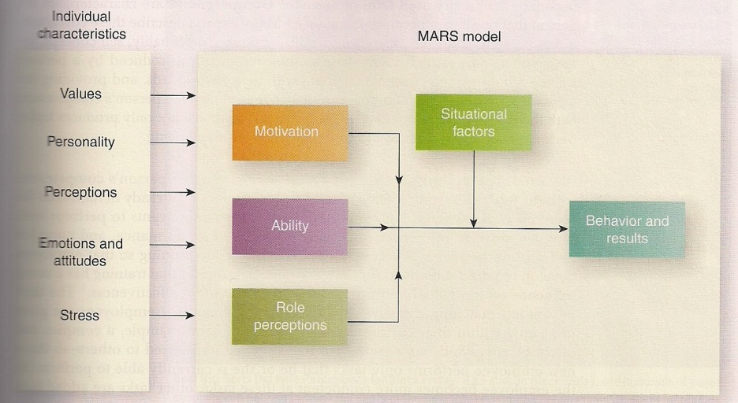
MARS Model of Individual Behavior
Four factors directly influence individual behavior:
Motivation
Ability
Role Perception
Situational Factors
Source: S McShane & M. von Glinow. 2009. Organizational Behavior [essentials]. McGraw Hill Irwin: New York. (ASSIGNED READING)

Slide 14
Motivation
The force within the person that affects their direction, intensity or persistence of voluntary behavior.
Direction: the path along which people engage their efforts
Intensity: the amount of effort one puts into completing task
Persistence: how long one sustains effort
What makes us do the things we do? Why would two individuals, in similar circumstances, choose two different options? The answer, in part, is motivation.

Slide 15
Ability
Ability includes natural aptitude and learned capabilities to accomplish assigned tasks.
Aptitudes: natural talents
Learned capabilities: skills and knowledge actually acquired.
The challenge is to match a person’s competencies with what each job requires.

Slide 16
Role Perception
Specific tasks and their associated duties and consequences to which we are accountable.
The roles help define the behaviors we should exhibit, and those we should not, when we do an assigned task.

Slide 17
Situational Factors
Situational factors can be internal or external to the organization.
Internal – time, budget, work facilities
External – economic situation consumer preferences

Slide 18
MARS
This is the MARS Model of Individual Behavior.
Be able to discuss its constituent elements and their sub-elements for Quiz 2.

Slide 19
Team Processes
Leadership
The nature of leadership
Power and Influence
Role of power and influence on behavior
Working in Teams:
The role of groups on productivity

Slide 20
Leadership
Leadership is the process of guiding and directing the behavior of people in the work environment.
Formal – organization bestows the authority to guide and direct
Informal – Unofficially accorded power by others.
A leader is an advocate for change and new approaches to problems VS.
A manager is an advocate for stability and the status quo.

Slide 21
Power and Influence
Power is the ability to influence someone else’s behavior.
Influence is the process of affecting the thoughts, and behavior of another person.
Authority is the right to influence another person.
Politics is the use of power and influence to further (personal) interests – some are acceptable, others not.

Slide 22
Working in Teams
A group of people with complementary skills who are committed to a common mission, performance goals, and approach for which they hold themselves mutually accountable.
Structure of work teams
Goals and objectives specify what must be achieved
Guidelines decide boundaries and limits of operation
Measures used to assess the performance of the team
Defined set of roles for team leaders and members.

Slide 23
Organizational Processes
Organizational Structure :
Is the division of labour and patterns of coordination, communication, workflow and formal power that direct organizational activities.
Elements of structure
Span of control – number of people reporting
Centralization/decentralization – people with decision-making authority
Degree of formalization- standardizing behavior through rules.

Slide 24
Organizational Processes
Organizational Culture is a set of values and assumptions shared within an organization.
Culture is made visible through practices and symbols of the organization
Values: reflects beliefs about what should be or should not be.
Assumptions: Deeply held beliefs that guide behavior and tell members how to think about things.

Slide 25
Invisible Client Model: Professionals work in Organizations
Organizations influence the behaviour of professionals
Group Influences
Organizational Influences
They bring to question whether primary loyalty is to profession OR to organization

Slide 26
Organizational Influence: Role of Organizational Structure
Pressures on professional behaviour
Knowledge of organizational structures is crucial to success in an organization.
How do information/commands flow?
Who can make decisions?
How formalized is the organizational structure ?

Slide 27
Different Organizational Structures
Departmentalization specifies how employees and their activities should be grouped together. It establishes a chain of command and coordination of information.
Organizational and management studies distinguish at least five major types of OS:
Line
Line and Staff
Functional
Project or Team
Matrix

Slide 28
Line Organization
Is the most hierarchical structure
Only departments that accomplish the mission of the organization.
There are only direct, vertical relationships among the different operations, or line departments, within a firm
Little horizontal communication
President
Production Manager
Supervisor 1
Supervisor 2
Marketing Manager
Sales Rep

Slide 29
Line and Staff Organization
President
Accounting Manager
Prod Manager
Marketing Manager
Supervisor
Supervisor
Creates a parallel chain of line and staff.
Staff provide advisory/ support role to line organization.
The accounting office reports to the president
It also provides financial advice and support to production and marketing
Line & Staff Organization

Slide 30
Functional Organization
A type of departmentalization that organizes employees around specific knowledge or resources.
Project is divided into segments and assigned to relevant functional areas/and or groups within functional areas
Employees develop narrow understanding of business. Poorer coordination across functions.

Slide 31
Matrix Organization
Employees are assigned to cross-functional teams working on specific projects.
They also belong to permanent functional units where they are redistributed to projects.
Optimum use of resources and expertise.
Employees are accountable to two managers. This can create ambiguity and conflict.

Slide 32
Organizational Influence: Role of Leadership Style
Different styles of Management leadership are another important influence on the professional practice
How does senior management deal with subordinates
Autocratic style – leaders take directive, controlling actions to enforce rules & activities.
Democratic style – takes collaborative, responsive, interactive actions with followers
Laissez-faire style – leader who fails to take the responsibility of position.

